Slide 1
Workshop Information literacy ICT English Course Searching and finding appropriate sources Nathalie van den Eerenbeemt, Frank de Nijs September 12th, 2013

Slide 2
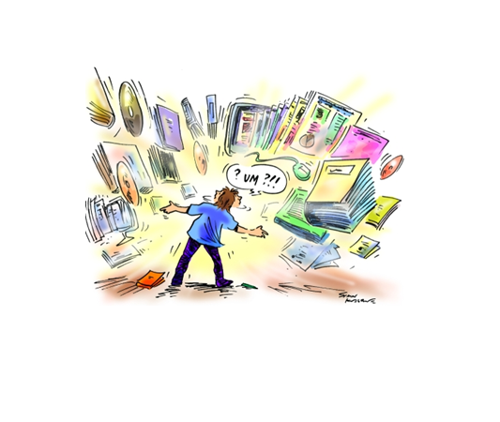

Slide 3
Why?
For your (internship or graduation) report, assignment, article, paper
How to write your literature references (APA standard) and bibliography
How te deal with copyright and plagiarism
Judging the value (reliability) of websites / information

Slide 4
Television
Internet
Google
social media
magazines
Where?
Companies
Libraries
newspapers
Institutions
Radio
Wikipedia

Slide 5
What do we do?
Roadmap to find information
Tips to find literature in the digital library / internet
Where can I find support / help?

Slide 6
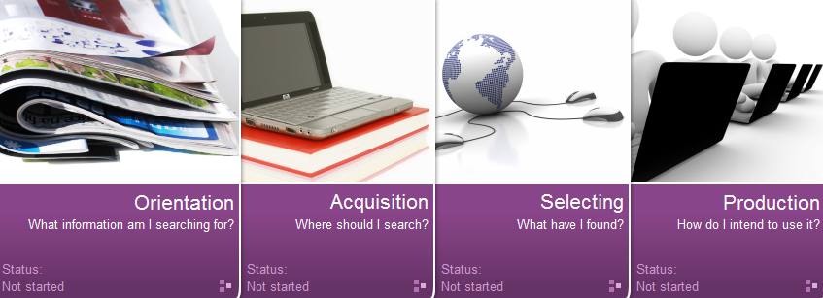
4 steps
What am I searching for?
Where should I search?
What have I found?
How do I intend to use it?

Slide 7

Internet
Notes:
We all use internet. How or where do you search on the internet? Google, wikipedia?

Slide 8

Notes:
What is your opinion about Wikipedia? Usefull / suitable for your study?

Slide 9
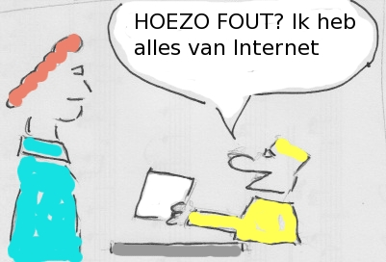
Reliable information
“How do you mean, WRONG? It all comes from the web”
http://www.fontysmediatheek.nl/wiki/home/Internet_searching:_reliability_of_information
Notes:
Link to wikipage how to judge information on reliability …

Slide 10
Wikipedia
Errors
Quick corrections
Reliability comparable to other encyclopedias
Article quality varies
Inbalanced (much space for irrelevant items)
Up to date
English <-> Dutch
http://nl.wikipedia.org/wiki/Actuaris

Slide 11

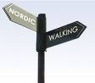

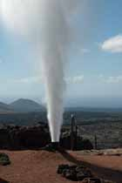
Wikipedia and study
starting point
verify
source?
Notes:
Wikipedia useful for your study? As a starting point, sure. Note: always verify! As a source? Not preferable: doesn’t have authority, tertiary source, some teachers are aversive.

Slide 12

Google
and research
Advanced search
“social media”, AND, OR, NOT, wildcards (*?), periode, taal, zinnen
Filteren: filetype (ppt, pdf), in title
Google scholar
http://scholar.google.nl/schhp?hl=l
Google books (look & feel)
Notes:
Advanced searching: searching on sentences, excluding words (Obama, not Barack), filter on filetype (bijv. ppt, pdf).
Language tools: translate text and webpages, direct search in other languages (Japanese: fontys): not perfect, but very useful.
Google Scholar (“social media”)
Language options.

Slide 13

Google
and research (2)
Google tips & trucs: workshop module Acquisition > internet (information )
Google Power Searching

Slide 14
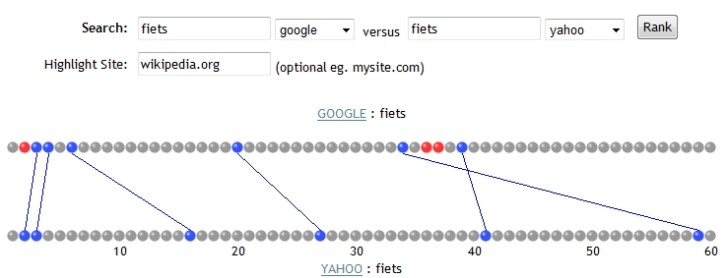
Search engines compared
Notes:
Andere zoekmachine gebruiken kan zinvol zijn: andere ranking van zoekresultaten.

Slide 15
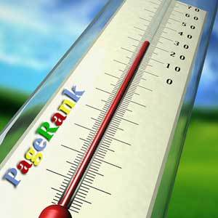
Page ranking
Notes:
Consider: pageranking is based on link populairity: not necessarily on information relevance

Slide 16
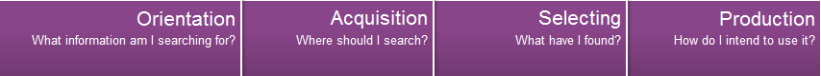
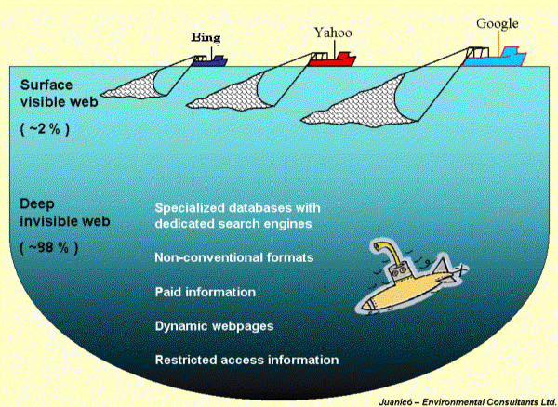
What is not found by Google?
password
paid
menus (choice)
flash
Notes:
Only a part of the internet has been indexed by general search engines. A big part of the deep web consists of databases (context: information resources). Here we meet the Fontys digital library. Fontys has licences on > 100 information resources.

Slide 17
What am I searching for? Translation of your research question to a literature or information question
Country / culture
How?
Orientation on subject
Period
Search terms
Sub questions
Language
Publication type
Main question
Angle / perception

Slide 18
Example research / main question
“What is the effect of using a smart board on the learning process of a pupil in primary education?”

Slide 19
Example sub questions
What is a smart board?
What kinds of smart boards / digital school boards are available?
Which distinct differences are there between the most common kinds of smart boards?
Which functions of smart board are beneficial for educational processes??
In case of which educational processes are smart boards most applicable?
Are there differences in learning effects for students of different age groups?

Slide 20
Search terms
Nederlands
basisschool; basisscholen; basisonderwijs; leereffect(en); leren; leerproces; leerling(en); leermiddelen; ict; digiborden; smartboards; digitale schoolborden; …..
Engels
elementary schools; elementary education; primary schools; primary education; learning; ict; technology enhanced learning; digital schoolboards; smartboards; IWB(s); Interactive whiteboard(s), digiboard(s) …..

Slide 21

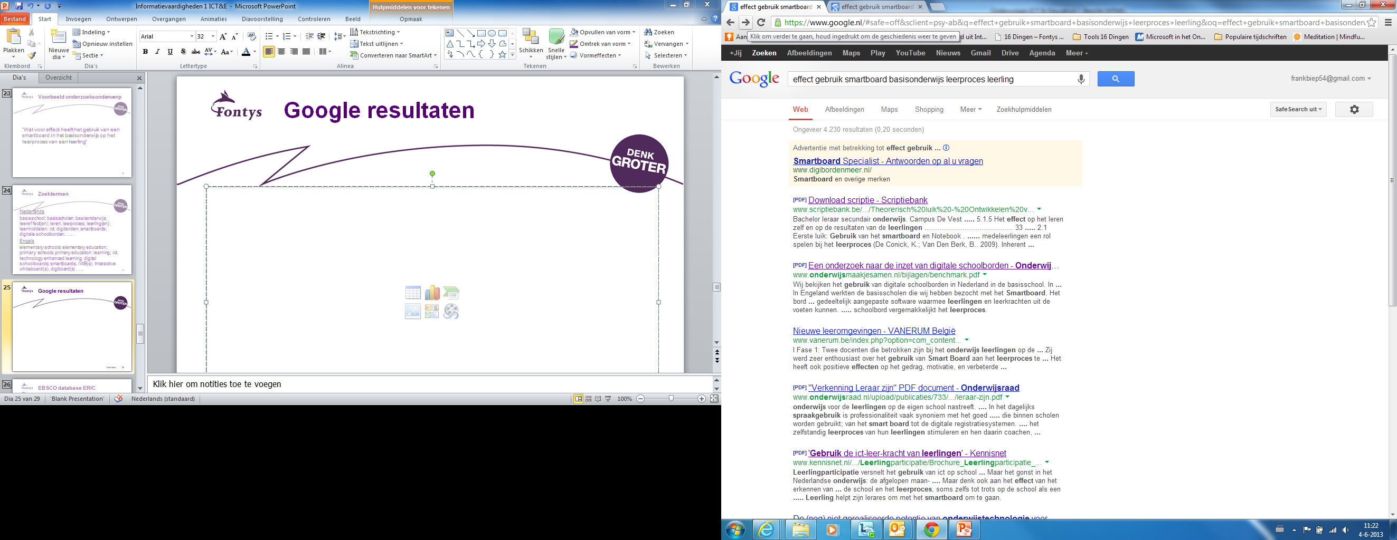
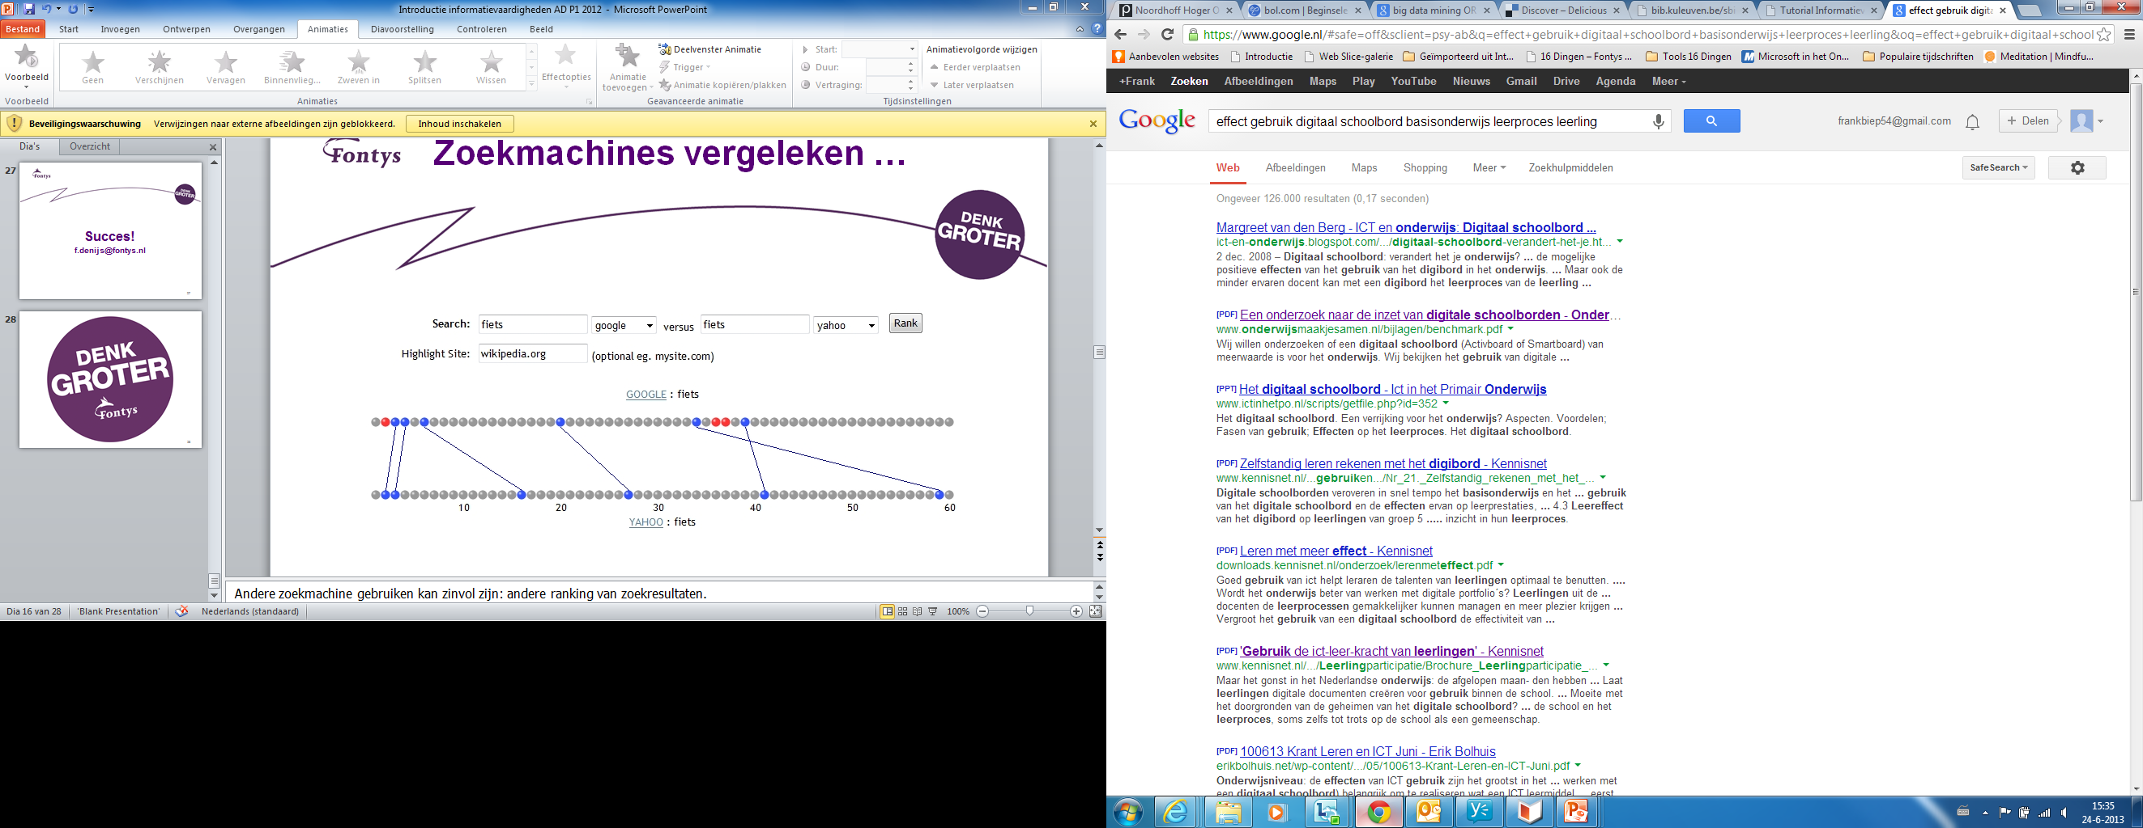
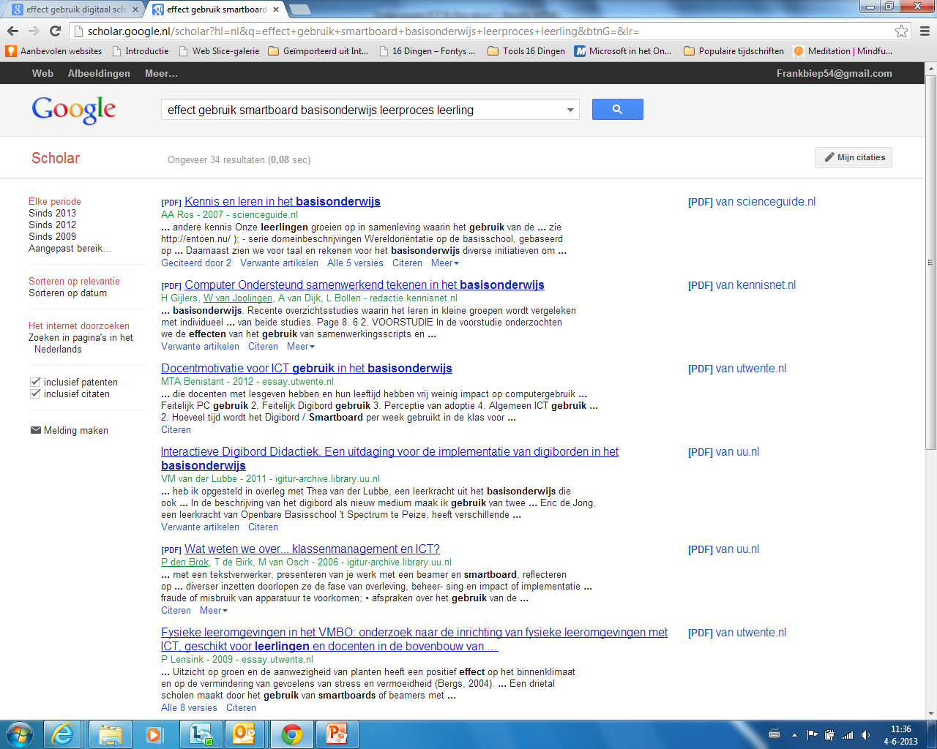


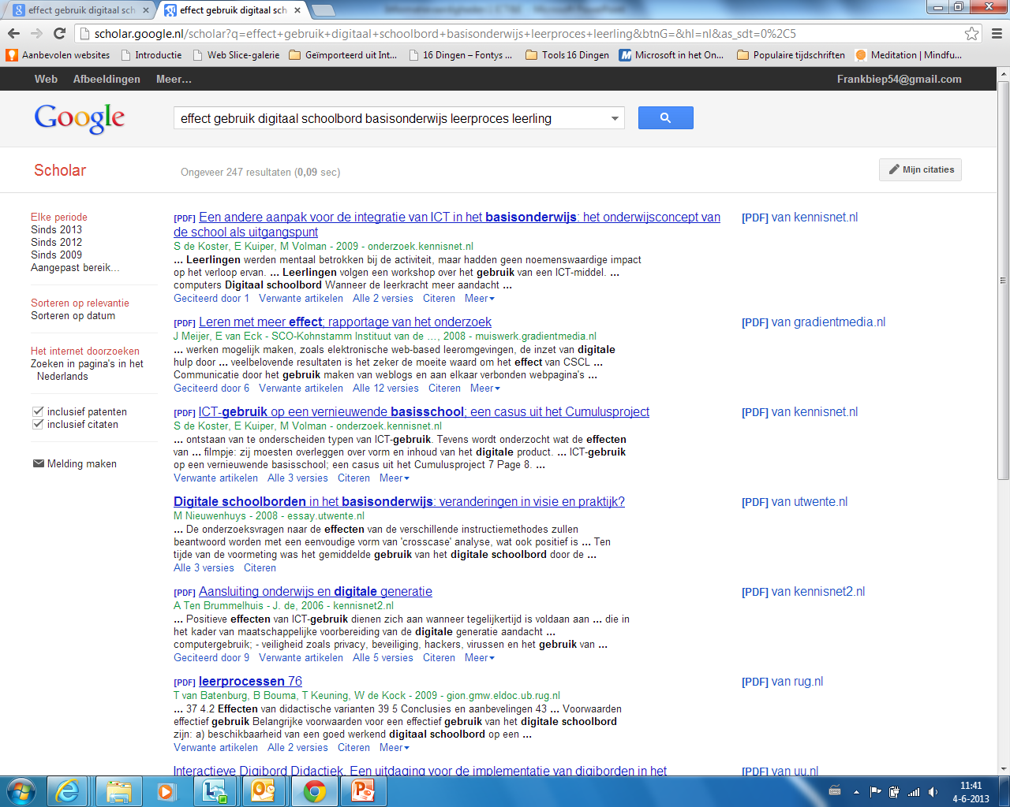

Google (Scholar) results
Notes:
Importance of search terms, different results, use of synonimes

Slide 22
Information Resources Fontys
Reliable information
Course specific information resources
University level
Paid info freely accesible
For example:
Biep.nu, Video’s, Kranten, Fontys eJournals Portal

Slide 23
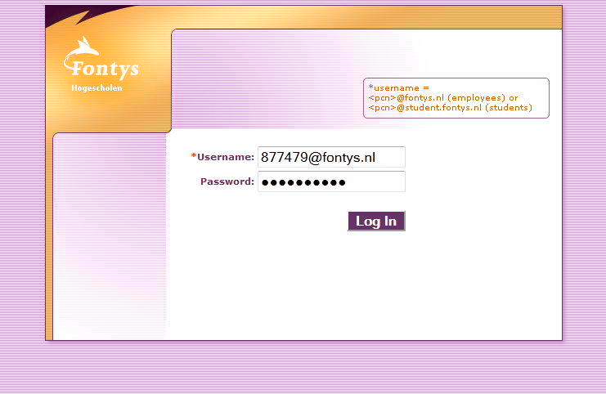
Login at home

Slide 24
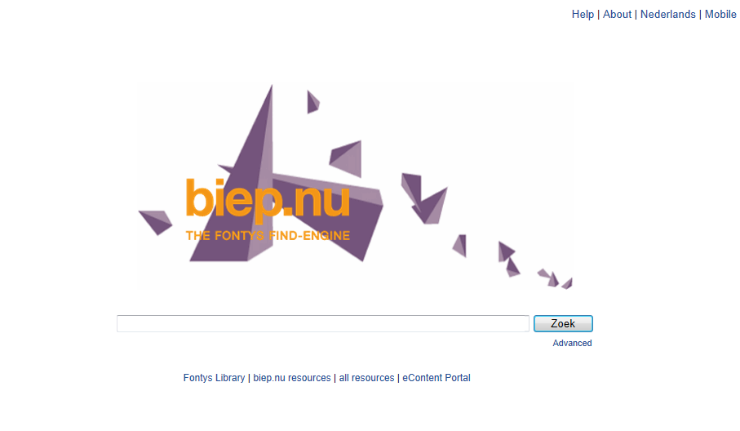
Biep.nu Searches Fontys resources at the same time (including the library collection)

Slide 25
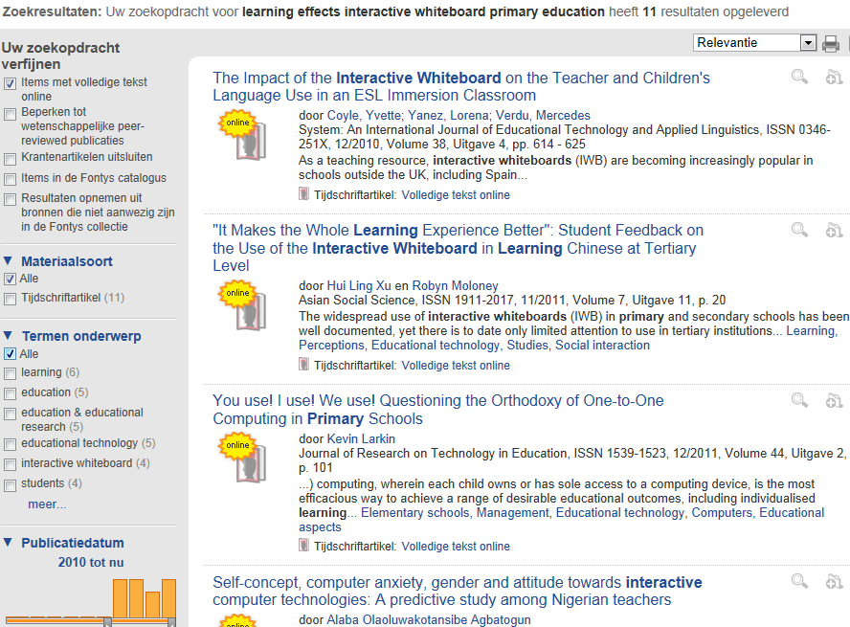

Biep.nu

Slide 26
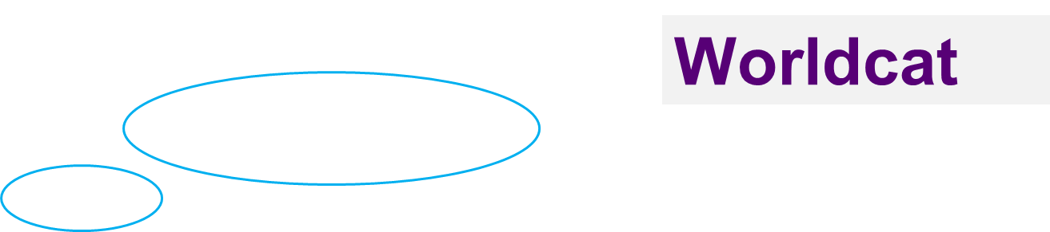
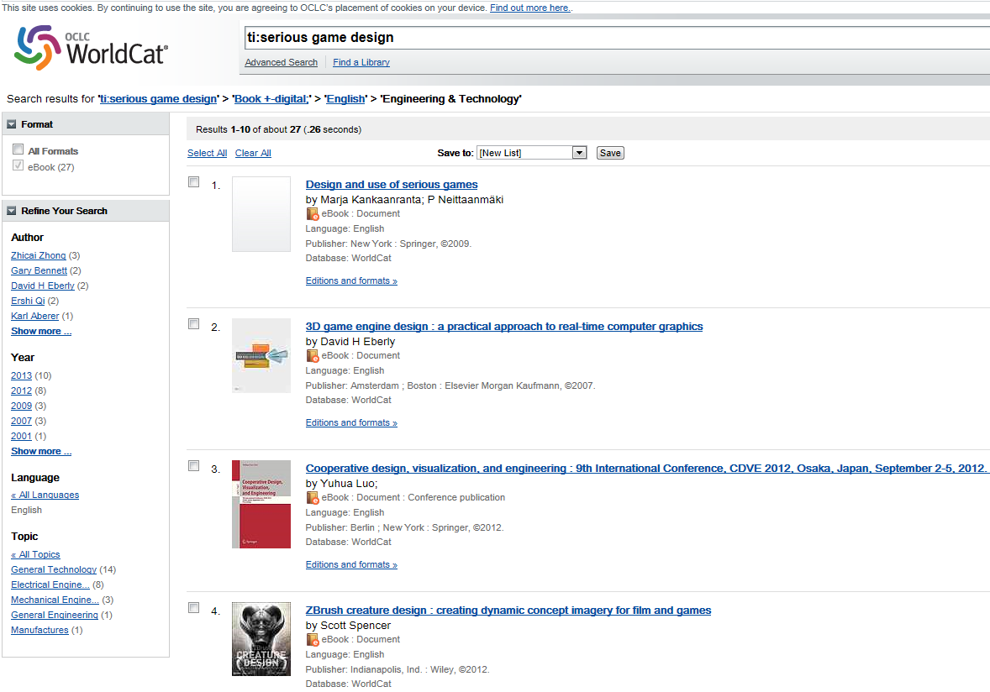
Change language

Slide 27
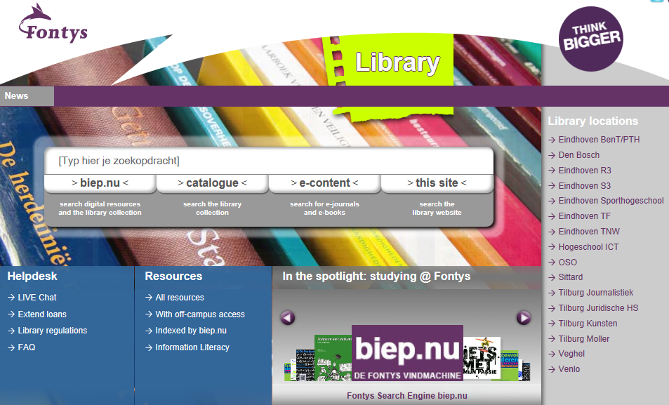
Does Fontys have a fulltext digital subscription (journal / ebook) ?
Fontys eContent

Slide 28

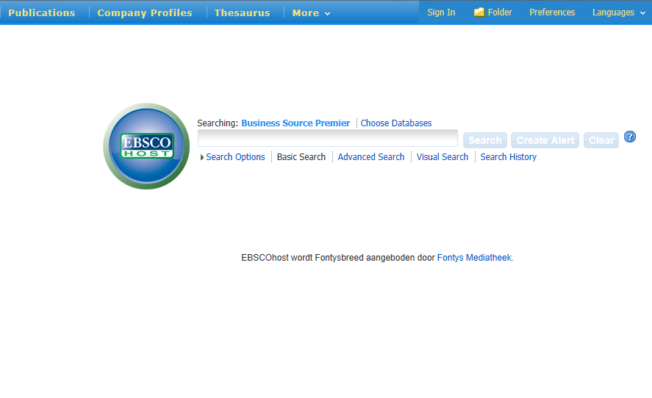
Business Source premier
English
Scientific
Fulltext artiles
Company Profiles

Slide 29
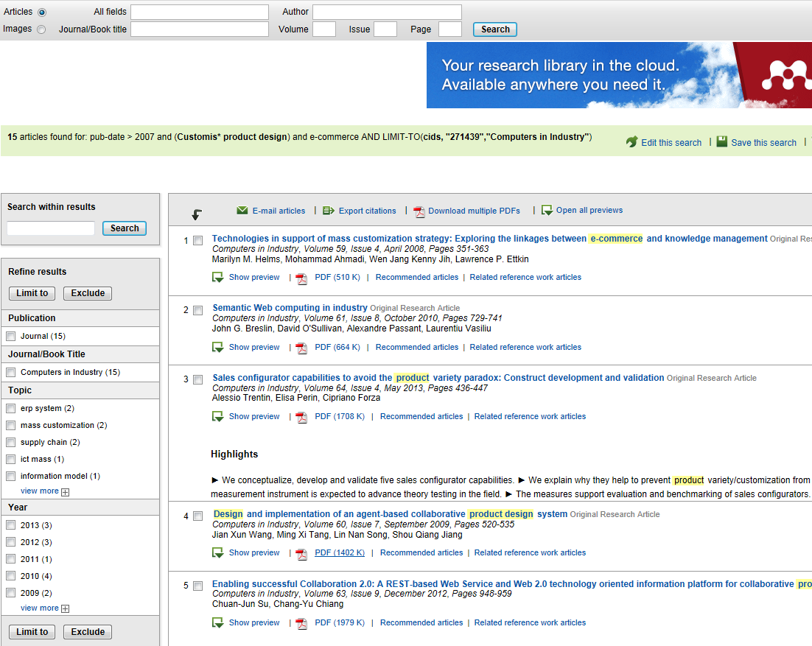



Slide 30

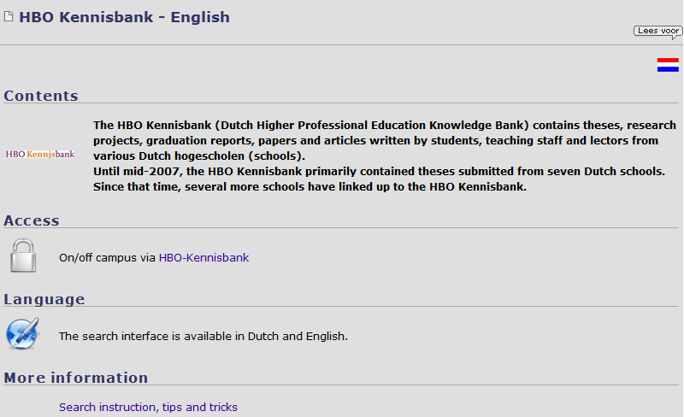
“Important gateway to research results of universities in the Netherlands” (bachelor)

Slide 31


STEP 3
3. What have I found?
- Is it recent?
- Is it an article, book
- Abstract / fulltext?
- From a scientific journal?
- Is the author a scientist or experience expert?
- Is the website usefull? (publisher)

Slide 32

STEP
4
4. Processing information
Reference listing (bibliography, APA), out of the text
Plagiarism / copyright
In Word documents

Slide 33
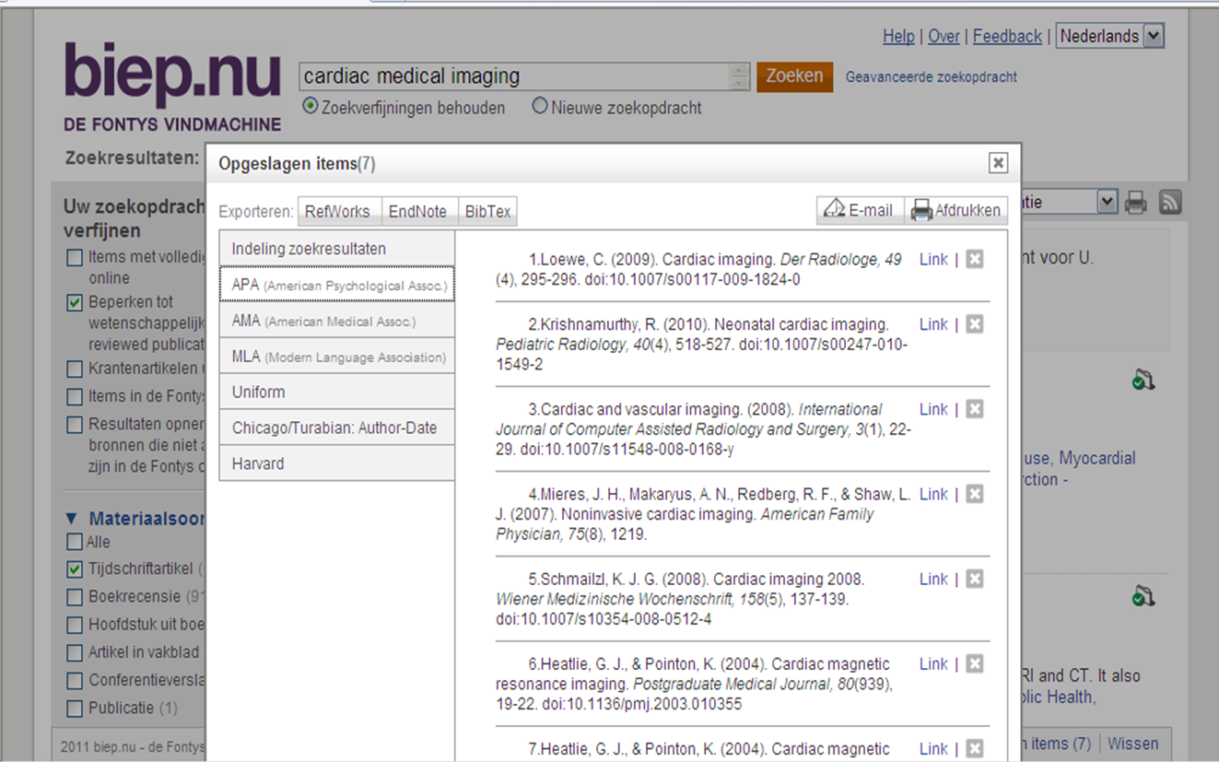
Reference listing in APA style within Biep.nu

Slide 34
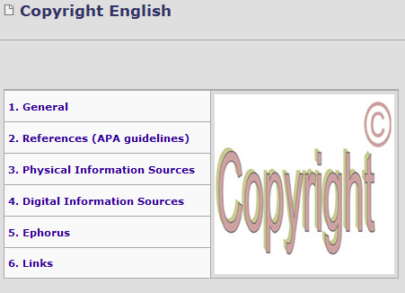
Link … Copyright & References
http://www.fontysmediatheek.nl/wiki/home/Copyright_English

Slide 35
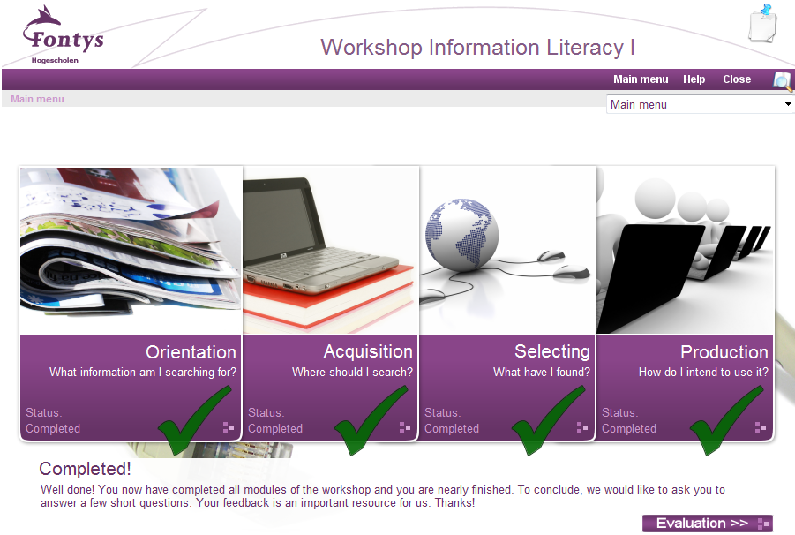

Registration & Sending results
http://www.fontysmediatheek.nl/informationliteracy/

Slide 36



At work …
Frank de Nijs, ICT
f.denijs@fontys.nl
Feel free to ask!

